Slide 1
l
Incidence of Autism Spectrum Disorders
Jean A. Frazier, MD
Executive Director, Eunice Kennedy Shriver Center
Robert M. and Shirley S. Siff Chair in Autism
Professor of Psychiatry and Pediatrics
UMass Medical School
Sept. 22, 2015

Slide 2
DSM-5 Autism Spectrum Disorder
Criteria for ASD
Two clinical domains (instead of the 3 in DMS-IV)
A-Deficits in social communication and social interaction (blends social with communication)
B-Restricted, repetitive patterns of behavior (includes insistence on sameness)
Symptoms must be present in early childhood
Symptoms must impair functioning
Notes:
A. Currently or by history
Social/Emotional Reciprocity: Decrease social approach and failure of normal back and forth conversation, reduced sharing of interests, failure to initiate social interactions
Nonverbal Communication in Social Interactions: Deficit in understanding and use of nonverbal communication (eye contact, body language, gestures)
Developing, Maintaining and understanding Relationships: Decreased ability to adjust behavior across social contexts, difficulties sharing imaginative play, no interest in peers
B. At least 2 present, currently or by history
Repetitive speech, stereotyped movements or repetitive use of object
Insistence on routines, ritualized verbal or nonverbal behavior, resistance to change
Fixated interests (intensity or focus)
Hyper- or hyporeactivity to sensory input or unusual interest in sensory aspects of the environment (indifference to pain/heat/cold, over-reaction to sounds or textures-noise in cafeteria, tags on clothes).
Bullet Two: May not become fully manifest until social demands exceed limited capacities, or may be masked by learned strategies later in life
Impaired Daily Living Skills
Not explained by intellectual disability or global developmental delay
Individuals with well-established DSM-IV diagnosis should be given the diagnosis of autism spectrum disorder. Individuals with marked deficits in social communication who do not meet criteria should be evaluated for social (pragmatic) communication disorder.
PDD, NOS will be most vulnerable to new rules

Slide 3
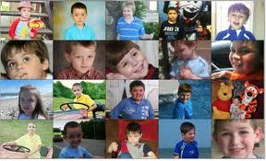
Diversity in Autism Spectrum Disorders
Intellectual level
Communication level
Behavioral level

Slide 4
PREVALENCE
1975: 1/5000
1985: 1/2500
1995: 1/500
2000: 1/150
2004: 1/125
2006: 1/110
2008: 1/88
2010: 1/68
© N of One: Autism Research Foundation
Notes:
Basis: Autism and Developmental Disabilities Monitoring (ADDM) Network
Medical and educational record retrospective review
8 year old children
11 sites (states)
2008 – 1 in 54- Male/Female ratio: (4.5-4.7):1
2010 - 1 in 42 boys
Broadening of diagnostic rules
Changes in Diagnostic Criteria
Better population sampling
Better diagnostic methods (especially among lower IQ and higher IQ children)
Greater Awareness and recognition
? Environmental Exposures

Slide 5
Prevalence and Extent of the Challenge
Highly heritable yet etiology is elusive in 80% of cases
75% of children with an ASD require treatment for emotional, physical or behavioral problems
One of the most challenging disorders for families and providers
Notes:
Behavioral = anxiety, ADHD, mood disorder, speech and language, sensory processing
Physical = sleep, gastrointestinal (GI), seizures
FiFth Bullet:
Emotional toll – “my child is in there somewhere”, strained relationships, increased stress on siblings and other family members
Financial Costs - $1.4 million to care for person with autism over their lifetime; $2.3 million if they also have an intellectual disability

Slide 6
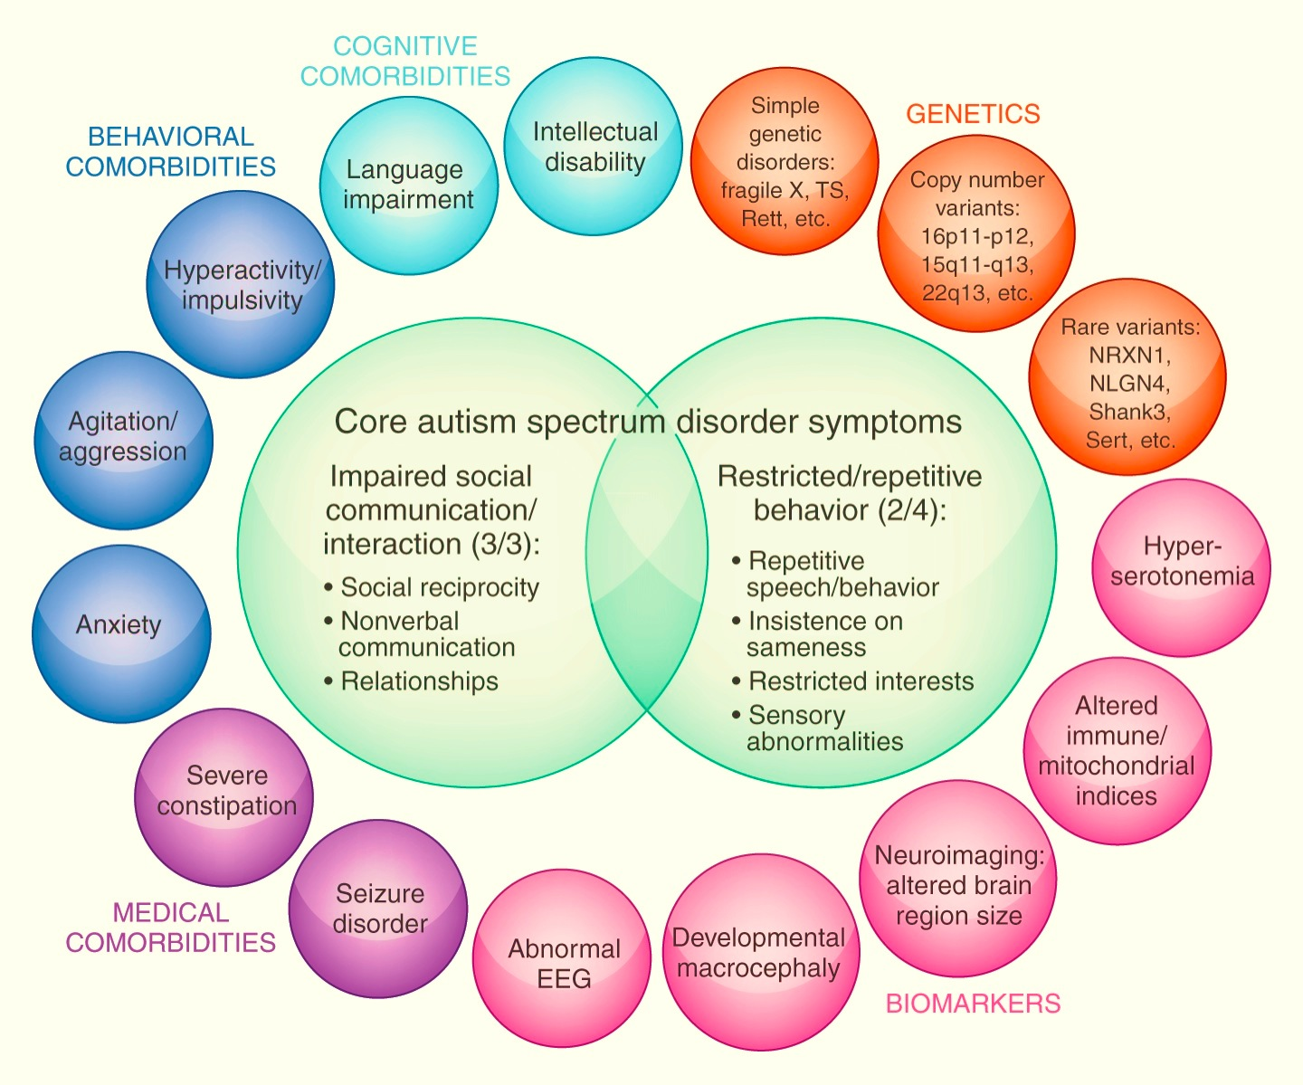

Slide 7
Medical Comorbidity and Psychopathology
Poor ability to report physical symptoms and sources of distress
Unusual pain tolerance
Missed medical problems may drive surface features that resemble psychiatric d/o
Irritable
Lowered threshold for baseline externalizing behaviors
Poor appetite and sleep
Motor restlessness
Charlot, L., Abend, S., Ravin, P., Mastis, K., Hunt, A., & Deutsch, C. Non-psychiatric health problems among psychiatric inpatients with Intellectual Disabilities. Journal of Intellectual Disability Research doi:10.1111/j.1365-2788.2010.01294.x

Slide 8
Medical Conditions in Autism
Higher rates of all medical conditions studied including:
Eczema
Allergies
Asthma
Ear and respiratory infections
Gastrointestinal problems
Severe Headaches and Migraines
Seizures (Kohane et al, 2012)
81% of parents of youth with ASD state their health concerns for their child had not be adequately investigated by professional (Treating Autism Survey, 2009)
Notes:
Many individuals with autism have comorbid health problems. The CDC Conducted a detailed assessment and found that children with autism had higher rates of medical conditions studied.
In the Treating Autism Survey, 76% of persons with autism also reported inadequate health care attention for concerns
In those who have been found to have a comorbid medical condition, parents were told in the past that it was part of the “autism” by health care providers multiple times prior to receiving the medical diagnosis (Treating Autism Survey, 2009)

Slide 9
Mortality Rate
Increased in ASD
Typically Gastrointestinal, Respiratory, Seizures
The elevated mortality rate is related to the comorbid medical conditions and intellectual disability rather than to ASD
Coordinated medical care for this population is critical
Bilder et al, 2012 ’Excess Mortality and Causes of Death In Autism Spectrum Disorders’
Notes:
Mortality rates are anywhere from 3-10 times higher than in the general population

Slide 10
Psychiatric Comorbidities
Communication Disorders
(Thought Disorder,
Disordered Pragmatics)
Attention Deficit Hyperactivity
(Executive Dysfunction, Hyperactivity, Impulsivity, Inattention)
Mood Disorders
(Mood Dysregulation, Anxiety, Depression, Mania)
Anxiety Disorders
(Social Interaction/“Empathy”:
?Shyness/Social Phobia,
Disinterest/Schizoid,
“Hostile Intent”/Schizotypal)
Asperger’s
Obsessive Compulsive Disorder
(Restricted interests
Rigid behavior
Stereotypic behavior
Compulsions)
Autism

Slide 11
What Challenges Does the Community ASD Population Have? (Lecavalier, 2006)
Easily Frustrated (60%)
Inattention (50%)
Hyperactivity (40%)
Temper tantrums (30%)
Irritability (20%)
Fearful/Anxious (13%)
Harming self (11%)
Destroying property (11%)
Physical fighting (5%)

Slide 12
Most Common Chief Complaint on Inpatient Admission
Aggression 28%
Self Injurious Behavior 23%
Property Destruction 17%
Tantrums 16%
Decreased Functioning 8%
Sexualized Behavior 4%
Elopement 4%

Slide 13
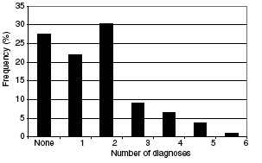
Comorbid Psychiatric Disorders in Autistic Children
Frequency of the number of comorbid lifetime DMS-IV psychiatric diagnoses per autistic child
Top 3: Specific Phobia (43% ), OCD (37% ), and ADHD (31%)
Leyfer O, Folstein S et al. J Autism Dev Disord (2006) 36:849-861
Notes:
Leyfer et al. modified the Kiddie Schedule for Affective Disorders and Schizophrenia (KSADS) for use in children and adolescents with autism by developing additional screening questions and coding options that reflect the presentation of psychiatric disorders in ASD. They call this modified instrument the Autism Comorbidity Interview—present and lifetime (ACI-PL). They piloted this instrument in a combined sample of 109 children and adolescents with autism from two cities (Boston and Salt Lake City). Subjects ranged in age from 5 to 17 years and met criteria for autism based on the ADI-R and ADOS. Known medial causes of autism were excluded by history, physical exam, karyotype, and Fragile X gene testing.

Slide 14
Comorbid Psychiatric Diagnoses Given by Community Providers Per Parent Survey (Rosenberg et al, 2011)
National on line registry established in 2006 - “Interactive Autism Network”
Parent report
4,343 participants between ages 5-18 years
Allowed for the assessment of community assigned comorbid diagnoses in ASD (rather than research assigned)
Examined factors associated with comorbidity (e.g. age, gender type and severity of ASD)

Slide 15
Comorbid Psychiatric Diagnoses Given by Community Providers Per Parent Survey (Rosenberg et al, 2011)
Notes:
45.2 % of those with one comorbidity had at least a second psychiatric disorder
Older age, diagnosis of Asperger’s Disorder and greater social impairment were associated with psychiatric comorbidity.
Lack of autistic regression, non Hispanic ethnicity, evaluation by a psychiatrist or psychologist and history of maternal psychiatric illness were associated with increased risk of psychiatric comorbidity.
Female gender was moderately protective for bipolar disorder and ADHD
Lack of variation with intellectual disability

Slide 16
General Intervention Aims
Reduce unsafe behaviors
Improve self-regulation skills
Increase positive social interactions
Increase parent/guardian management skills
Acquire adequate community supports to sustain post-discharge
Notes:
Successful treatment requires an interdisciplinary diagnostic approach that manages acute/chronic symptoms, ameliorates key perpetuating factors, such as sleep deprivation, communication inefficiency or environmental reinforcement of maladaptive behaviors.

Slide 17
Treatment of Autism Spectrum Disorders
Multi-Modal Approach
Behavioral
Educational
Pharmacological
Target Appropriate Developmental Stage
Early Assessment and Intervention
Ongoing Therapy

Slide 18
Impact of Autism on Family
Increased stress for each family member
Primary focus becomes helping the individual with autism
May put additional stress on:
Marriage
Other children
Work
Personal relationships
Finances

Slide 19
American Academy of Pediatric Guidelines
Identification and Evaluation of Children With Autism Spectrum Disorders
Pediatrics, 2007;120:1183-1215
Management of Children With Autism Spectrum Disorders
Pediatrics, 2007;120:1162-1182
Recommendations for Evaluation and Treatment of Common Gastrointestinal Problems in Children With ASDs
Pediatrics, 2010;125 Suppl 1;S19-S29
19

Slide 20
American Academy of Pediatrics Toolkit
Autism: Caring for Children With Autism Spectrum Disorders: A Resource Toolkit for Clinicians
Contents
CD
Physician fact sheets
Family handouts
Supporting documents
Printed materials
Poster (CDC “Act Early” campaign)
Brochure samples
www.aap.org/publiced/autismtoolkit.cfm
20

Slide 21
CANDO Center for Autism and Neurodevelopmental Disorders
Phone: 774-442-2263
FAX:
774-442-2270
Email: Cando@umassmemorial.org

